Slide 1
WELCOME

Slide 2
Submitted By
Dipanjan Swarnakar
ID: 021172010

Slide 3
TOPIC : Design of local minima/maxima circuit

Slide 4
Scope of Project:
•To design a simple digital circuit that accumulate the input numbers.
•To find the maximum and minimum of a series of input numbers.

Slide 5
Features:
Clean of violations,
Minimizing the area;
Have balanced clock tree with less than 50ps skew.
1 GHz frequency

Slide 6
Benefits:
Applications in which it is desired to find the maximum or minimum value
Important for linear algebra and game theory

Slide 7
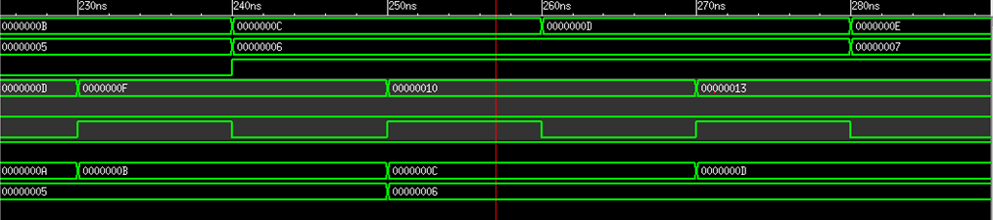
Outputs : Circuit, Simulate

Slide 8
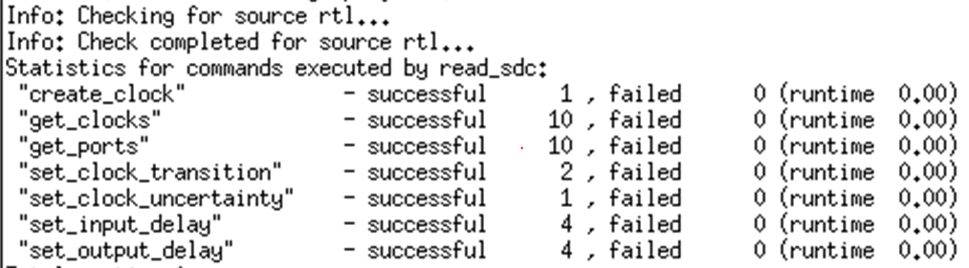
Synthesize

Slide 9
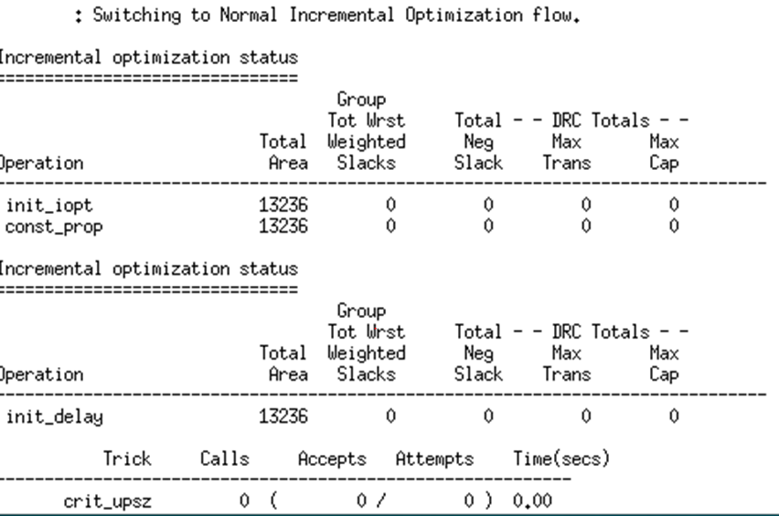

Slide 10
Place & route the design

Slide 12
Any Questions?

Slide 13
Thanks for your Patience

